Slide 1


Energy Efficiency Analysis and Optimization of A Typical Deep Learning Application
Final Thesis Defense
Name：Abid Ali
Advisor: Zhengxiong Hou
Date：23-06-23

Slide 2

CONTENTS
01
02
Introduction
Energy Efficiency Analysis and Optimization of A Typical Deep Learning Application and Research Objectives
Related Work
Typical Deep Learning Applications
03
04
CNN Model
Energy Efficiency Analysis
Simple Convolutional Neural Network Models For Mnist Digit Recognition
Energy Efficiency Analysis of CNN with DVFS on CPU
Research on Power Capping Technology
05
06
Power Capping Technology
Model Optimization
Energy Efficiency model

Slide 3

PART 01
Introduction
Energy Efficiency Analysis and Optimization of A Typical Deep Learning Application and Thesis Objective

Slide 4






1.1Research Background
Today, data centers consume around (2-4)% of all electricity worldwide and the number keep increasing.

Slide 5
1.1Research Background(Cont.)
In large data centers, energy saving and consumption reduction for these major applications is very important, which is conducive to reducing operating costs and carbon emissions.
Today, people are not only concerned about the performance of the application, but also the energy efficiency of the application.
Performance, power consumption, and energy consumption of deep learning applications are related to the upper limit of component power, the total number of CPU cores, and CPU frequency, etc.
This thesis intends to analyze its energy efficiency and study optimization methods for a typical deep learning application,

Slide 6



1.1Research Background(Cont.)
Computer technology has had a transformative impact on various aspects of human life and has significantly contributed to scientific research, industrial development, education, and national defense and military.
Scientific Research
Computers have revolutionized scientific research. For example
Complex simulations
Data analysis
Modeling
Industrial Development
Computers have played a crucial role in industrial development and automation.
Computer-aided design (CAD)
Computer-aided manufacturing (CAM)
Education and Teaching
Computers have transformed education and teaching methodologies.
e-learning,
online courses
vast educational resources

Slide 7
1.3 Research Status
(1) Linux DVFS Technology
①performance directly adjust the CPU frequency to the maximum so that we get highest performance and highest power consumption.
②powersave directly adjust the CPU frequency to the lowest so that we get the lowest performance and lowest power consumption.
③userspace adjust the CPU frequency to the frequency manually set by the user.
④ondemand according to CPU the load dynamically adjusts the frequency. When the load is higher than a certain threshold, the frequency is adjusted to the maximum, and when it is lower than a certain threshold, frequency is reduced.
⑤conservative depends on the CPU load dynamically adjust the frequency. Compared with ondemand, the frequency adjustment range is smaller and the strategy is more conservative but more power saving

Slide 8
1.3 Research Status
(2) Power Capping Technology
Powercap settings to help compute nodes perform fine-grained powercap allocation.
(3)Energy Efficiency by using Model Optimization
As power shortages and cost rise, energy efficiency has become more crucial in high-performance computing data centers
I have proposed model optimization which simplify a complex model to a lightweight model
It involves various techniques aimed at reducing model size, decreasing computational requirements, improving inference speed, and enhancing overall model quality

Slide 9
PART 02
Related Work
Typical Deep Learning Applications & Experiment Setup

Slide 10
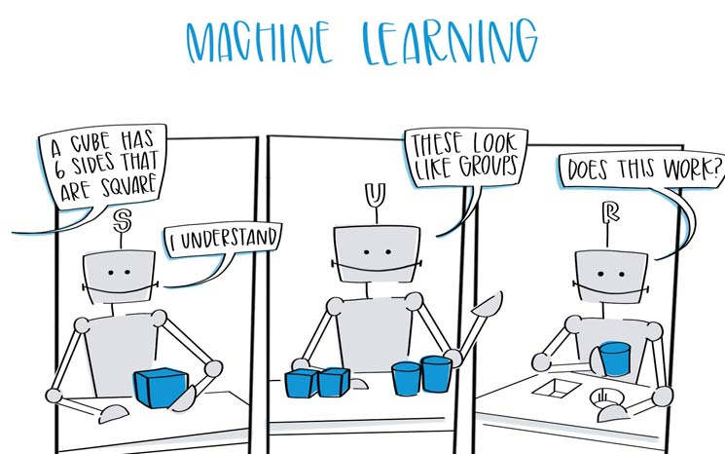
2.1 Deep Learning Applications
The deep learning (DL) computer paradigm has recently recognized by the machine learning (ML) community as the Gold Standard.
Most popular computational strategy in the area of ML
Number of challenging cognitive tasks
Capacity to learn from enormous volumes of data
DL has outperformed well-known traditional ML techniques in many domains
CNN Based Model
Deep learning (DL), which is often referred to as representation learning (RL), has emerged as a popular choice among the different ML algorithms used in these applications
Typical convolutional neural networks (CNNs) are usually computationally intensive
Training with large mini-batches
Training DNNs in a distributed environment with multiple GPUs and machines
The deep learning (DL) computer paradigm has recently recognized by the machine learning (ML) community as the Gold Standard.
Most popular computational strategy in the area of ML
Number of challenging cognitive tasks
Capacity to learn from enormous volumes of data
DL has outperformed well-known traditional ML techniques in many domains
.

Slide 11
2.2 Framework Selection & Dataset
open-source DNN frameworks
TensorFlow
Caffe
Torch
Keras
PyTorch
Since no single framework has emerged as the dominant leader in the field and since different framework-specific design choices and optimizations might lead to different results
MNIST dataset
We used MNIST dataset for the experiment.The MNIST database (Modified National Institute of Standards and Technology database) is a large database of handwritten digits that is commonly used for training various image processing systems. The database is also widely used for training and testing in the field of machine learning.

Slide 12
2.3 Summary
A CNN consists of an input layer, an output layer, and multiple hidden layers. The hidden layers of a CNN typically consist of convolutional layers, pooling layers, and fully connected layers.
Convolutional layers apply require bulky networks to achieve accuracy.
In CNNs, convolution takes the majority of the energy. Specifically, convolution with multiple layers consumes more than 90% of the total energy resources .
To solve the above problems, I have proposed a light-weight attention-fused CNN for Energy Efficiency and Optimization.

Slide 13
PART 03
CNN Model
Simple Convolutional Neural Network Models For Mnist Digit Recognition

Slide 14
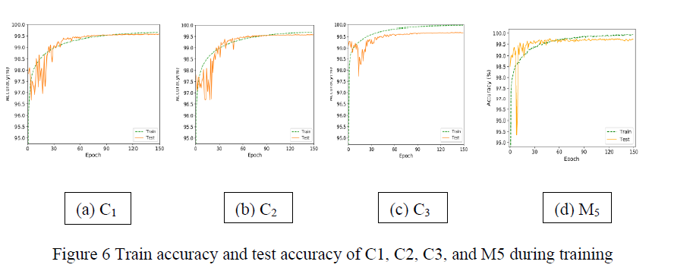
3.1 Introduction
Data set for the MNIST handwritten digit recognition is one of the most basic data sets used to test performance of neural network models and learning techniques Using 60,000 images as the training set .
Convolutional neural networks (CNN) improve this accuracy to over 99%
We require more complicated models, careful adjustment of hyperparameters using learning rate and batch size, regularization techniques such as batch normalization and dropout, and augmentation of training data to enhance accuracy after 99%..
According to the publications, the maximum accuracy on the MNIST test set was between 99.7% and 99.84%

Slide 15
3.2 Network Design and Training
At the end of a model's several convolutional layers lies a fully linked layer. Each convolution layer performs a 2D convolution, 2D batch normalization, and ReLU activation.
Max pooling or average pooling is not used after convolution. Instead, the size of feature map is reduced after each convolution because padding is not used.
For example, we used a 3 × 3 kernel, the width and height of the image is reduced after each convolution layer. Similar approach is taken in other networks feature map size becomes small enough.
A fully-connected layer connects the feature map to the final output. A 1D batch normalization is used at the fully-connected layer.

Slide 16
3.2 Network Design and Training (Cont.)
Figure : Network models used for MNIST digit classification
The first network, M3, uses 10 convolution layers with 16(i + 1) channels in ith convolution layer. The feature map becomes 8×8 with 176 channels after the 10th layer.
The second network, M5, uses 5 convolution layers with 32i channels in ith convolution layer .

Slide 17
3.3 Impact of Data Augmentation
When training the proposed network, we used two schemes for data generation: random rotation and random translation.
For random translation, an image is randomly shifted horizontally and vertically, up to 20% of the image size in each direction. For random rotation, the image is rotated up to 20 degrees in either clockwise or counterclockwise direction. The amount of transformation varies for each image and each epoch, so the network gets to see various versions of an image in the training set

Slide 18
PART 04
Energy Efficiency Analysis of CNN with DVFS on CPU
Energy Efficiency Analysis

Slide 19
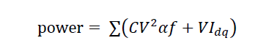
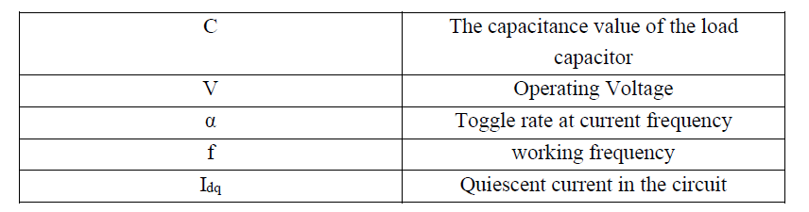
4.1 DVFS Technology
DVFS（Dynamic Voltage and Frequency Scaling）Dynamic voltage frequency adjustment is a real-time voltage and frequency adjustment technology.
Its function is to evaluate the current actual load and power demand of the components, and then dynamically set the clock frequency and working voltage of the components, so that the power provided by the system can meet the requirements of certain components.

Slide 20
4.2 Principle of FM Method
Frequency modulation methods commonly used in Linux operating system
performance：Directly adjust the CPU frequency to the maximum, the highest performance, the highest power consumption.
powersave：Directly adjust the CPU frequency to the lowest, the lowest performance, the lowest power consumption.
userspace：Adjust the CPU frequency to the frequency specified by the user.
ondemand：Dynamically adjust the frequency according to the CPU load. When the load is higher than a certain threshold, the frequency will be adjusted to the maximum. When it is lower than a certain threshold, the frequency will be reduced to an appropriate frequency to reduce power consumption while meeting certain performance.
conservative：Dynamically adjust the frequency according to the CPU load. Compared with ondemand, the frequency adjustment range is smaller, the strategy is more conservative, but it saves more power.

Slide 21
4.3 Testing Frequency Modulation Methods for the Performance and Energy Efficiency of CNN
We use the CNN model program to test the five frequency modulation methods. And use some tools to monitor the entire operation process of CNN model,
nvidia-smi
top tool
likwid tool
Data visualization
nvitop

Slide 22
PART 05
Research on Power Capping Technology

Slide 23
5.1 Introduction to Power Capping Technology Technology and Implementation
Power capping technology is a mainstream method for optimizing application energy efficiency. Can be applied to CPU, DRAM and GPU. Its function is to modify the power cap of system components (such as CPU, GPU, etc.) to an appropriate value .
We hope that in the case of reducing power consumption and energy consumption, the performance will not be reduced too much, so that power consumption-performance and energy consumption-performance .

Slide 24
5.2 Power Capping Experiment
Power capping technology is a mainstream method for optimizing application energy efficiency. Can be applied to CPU, DRAM and GPU.
In this experiment, we mainly conduct Power Capping experiments on the core components of the system: CPU, and GPU, quantify the results and analyze various results, so as to provide a basis for subsequent system energy efficiency optimization.

Slide 25
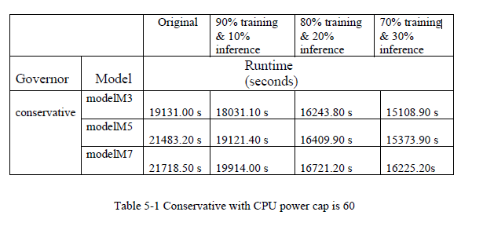
5.2 Power Capping Experiment
CPU Power Capping
In this experiment, the CNN program was used for testing, the CPU frequency adjustment policy is conservative the CPU power cap is 60, the upper limit of GPU power is 250Watt, and the upper limit of DRAM power is 12Watt.

Slide 26
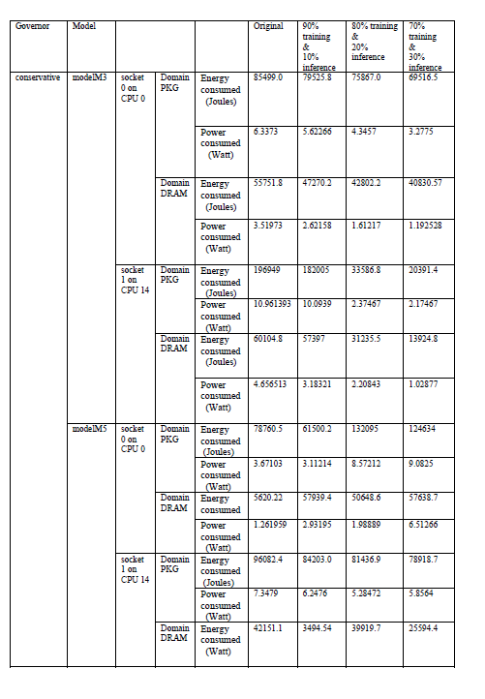
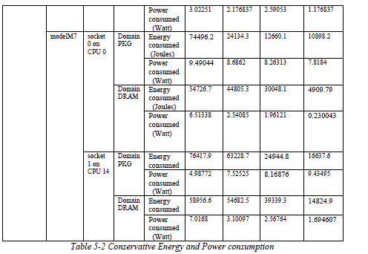
5.2 Power Capping Experiment

Slide 27
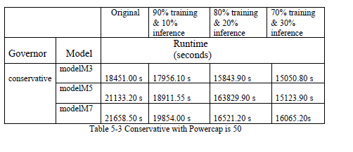
5.2 Power Capping Experiment
In this experiment, the CNN program was used for testing. The number of CPU cores is 20, the CPU frequency adjustment policy is conservative the CPU power cap is 50, the upper limit of GPU power is 250Watt, and the upper limit of DRAM power is 12Watt

Slide 28
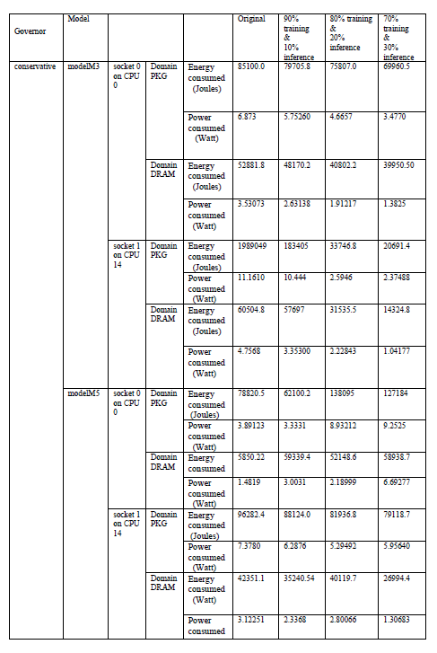
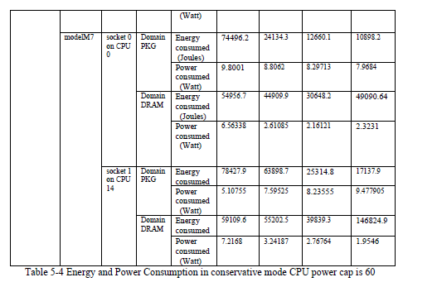
5.2 Power Capping Experiment

Slide 29
5.3 Key Technology
1. CNN Architecture
2. DVFS
3. Powecapping

Slide 30
5.4 Analysis
It can be observed that as the power limit of the CPU continues to decrease, the power and energy of the CPU is also continuously reduced.The pressure on GPU increased gradually then GPU starts to take more load to maintain a balance while the power of the DRAM remain unchanged .
Here we can see that when CPU power cap is 60 modelM3 needs 19131.00 seconds to complete the CNN program but when the CPU power cap is 50 modelM3 is 18451.00 s.
In this situation we can see from comparing the above tables that when CPU is power cappped to GPU start to take more load which increase the GPU utilization 20-30% from 6-12% this can be analyze by nvitop tools(nvidia-smi).If we reduce the powercap further more than 40 then GPU and CPU start to consume more power and takes more time to execute the program.
This phenomenon is evident for other two model M5 and M7. Therefore we can say that setting the CPU powercap at 40 is the most optimal under this condition

Slide 31
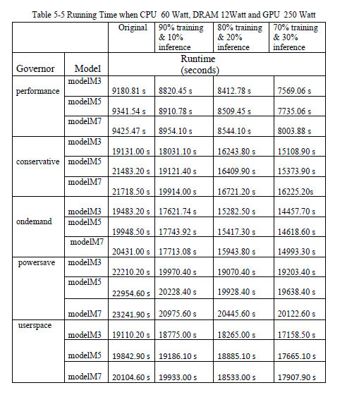
5.5 GPU Power Capping
The CNN model operation table of performance, conservative, ondemand, powersave, and userspace (800KHz) respectively and the CPU power limit is 60 Watt, the DRAM power limit is 12Watt and GPU was set to 250 Watt (Default) where we used, batch_size=120 for training

Slide 32
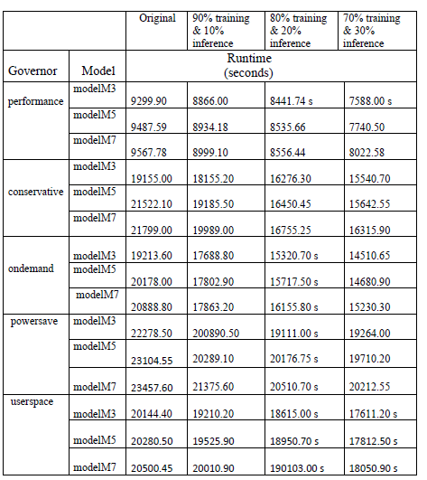
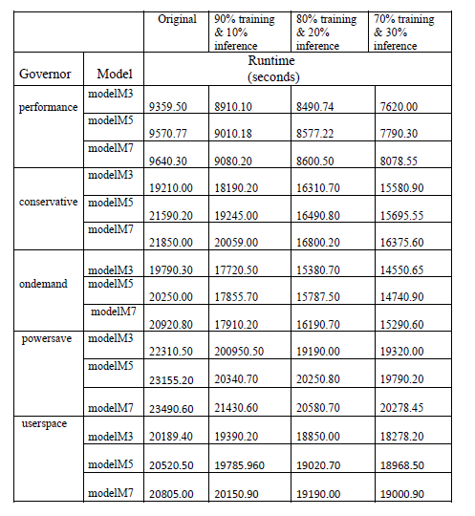
5.5 GPU Power Capping
Running time when GPU 230,Dram 12 & CPU 60
Running time when GPU 210,Dram 12 & CPU 60

Slide 33
Optimize Energy Efficiency by Selecting the Optimal Parameters, DVFS policies, Power Capping Values and Model Optimization
PART 06
Ending and Future Works

Slide 34
6.1 Analysis of Model Optimization
When building a CNN, a common practice is to use pooling, such as max pooling or average pooling]. Pooling is used to obtain translation invariance and also reduce dimension of the feature maps. A commonly used CNN model consists of a set of convolution layers where each convolution layer is followed by a pooling layer, and one or multiple fully connected layers at the end. Some networks have two convolution layers before the pooling layer. Some of the commonly used CNN structures, and we name the three networks C1, C2, and C3

Slide 35
6.2 Energy Efficiency by using Model Optimization
On the other hand, the test accuracy of M5 increases in a more stable manner. shows the test accuracy of 30 networks between 50 epoch and 150 epoch of training. The average test accuracy of C3 better than that of C1 and C2, which means using more convolution layers could result in better feature learning.
Having more fully connected layers at the end did not help, as can be seen from the accuracy of C1 and C2.

Slide 36
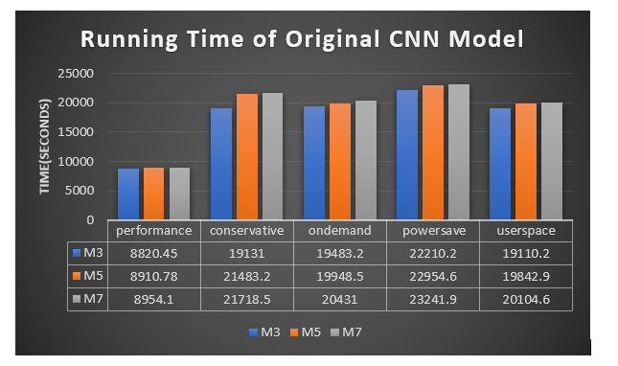
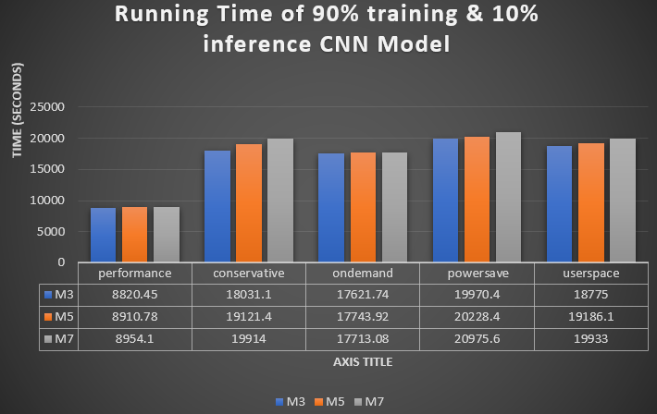
6.3 Power Capping Value
CPU power limit is 60 Watt, the DRAM power limit is 12Watt and GPU was set to 250 Watt (Default) where we used batch_size=120 for training
CPU power limit is 60 Watt, the DRAM power limit is 12Watt and GPU was set to 250 Watt (Default) where we used batch_size=120 for training

Slide 37
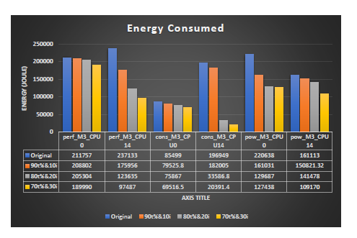
6.3 Power Capping Value
We can see the that,performance mode(perf) consume maximum energy.Surprisingly powersave also consume a lot of energy because it runs for a long time compared to other modes.By doing different experiment in different ,we can see thatconservative mood gives the optimal solution for this problem which has a balance tradeoff between time and energy consumption

Slide 38
6.4 Optimize Energy Efficiency by Selecting the Optimal Parameters, DVFS policies, Power Capping Value
We can see that performace take the least time to finish the task but it consumes a large amount of energy compared to other modes.
By careful observation and doing lot of experiments in different scenario.We can come to the conclusion that, conservative is the best option based on running time of the program and energy consumed.

Slide 39
PART 07
Conclusions
Ending and Future Works

Slide 40
Conclusions
This paper starts with the basic DVFS technology, learns the principle of DVFS technology and understands how DVFS technology is used in the energy efficiency optimization for A Typical Deep Learning
Preliminary tests of performance, energy consumption, power consumption and other indicators show that the best frequency tuning method for A Typical Deep Learning Application is conservative.
In summary, the proposed methods are effective for speech denoising and show promising results.
Then, in order to verify that the frequency adjustment strategy of the CPU and the Power Capping technology can be used overlappingly, we conducted an overlap test and found that the Power Capping technology can indeed be used together with the frequency adjustment.
Then we used a light weight CNN model for Energy Efficiency Analysis and Optimization known as Model optimization which refers to the process of improving the performance, efficiency, and resource utilization of a machine learning model. It involves various techniques aimed at reducing model size, decreasing computational requirements, improving inference speed, and enhancing overall model quality

Slide 41
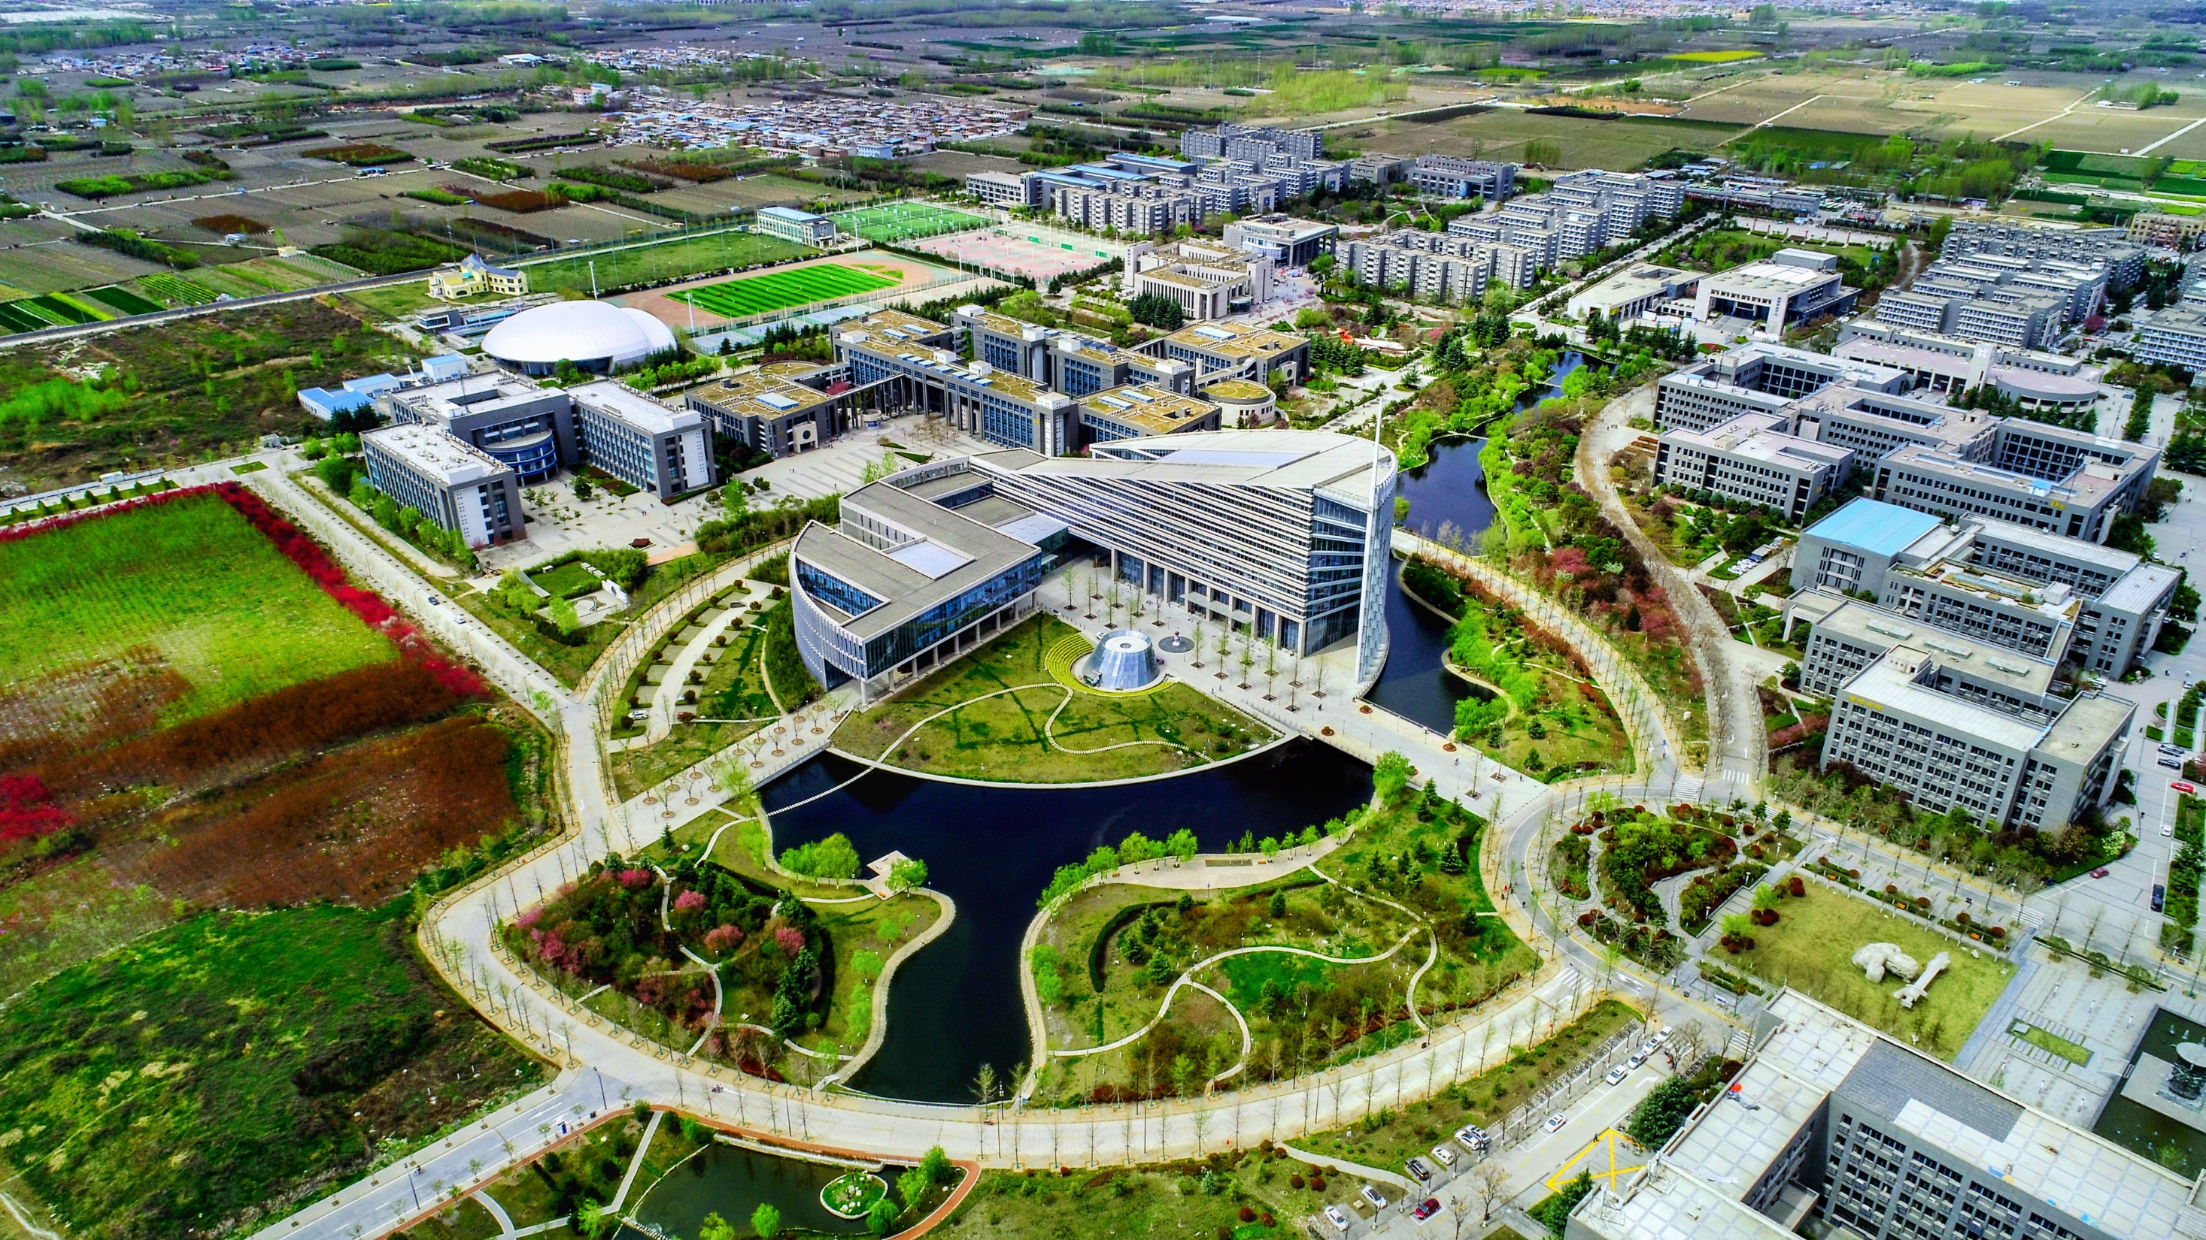

Thanks
Abid Ali
2019380141

